Slide 1
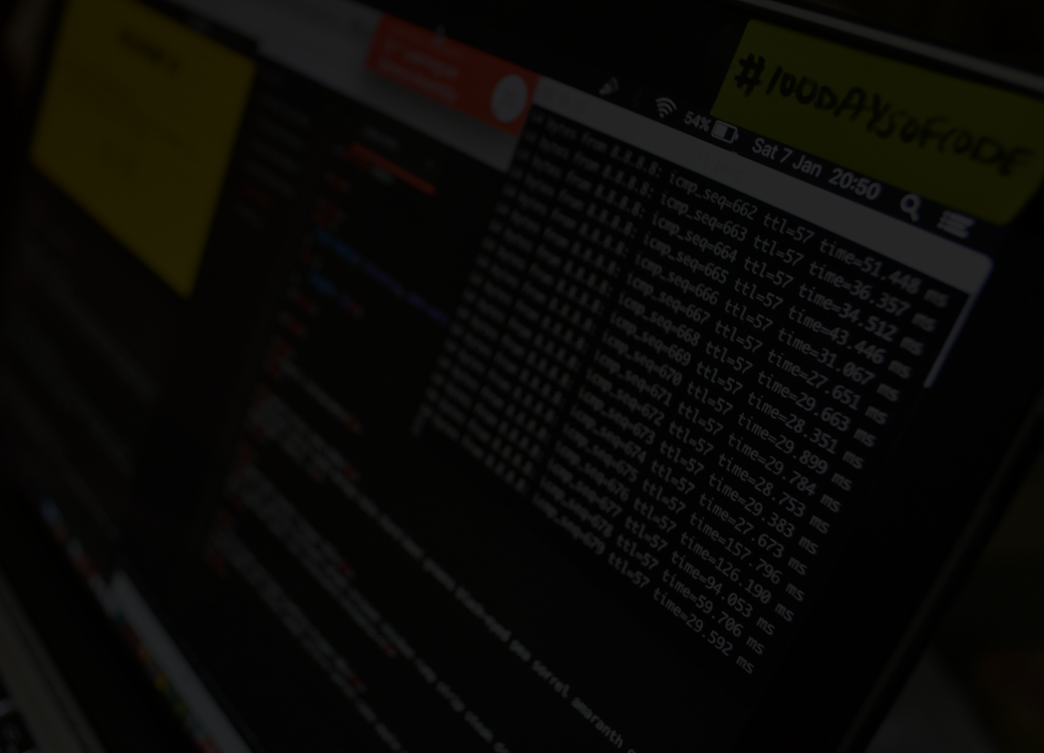

PROTOTYPE POLLUTION
By Darrshan (Fedwig)

Slide 2
FIRSTLY...
WHAT ARE PROTOTYPES?

Slide 3



> What are prototypes in JavaScript?
Prototypes in JavaScript are objects that other objects can inherit properties such as keys and methods.
JavaScript is a prototypal language, meaning it uses prototypes to define object behavior instead of traditional class-based inheritance like in Java or C++.

Slide 4
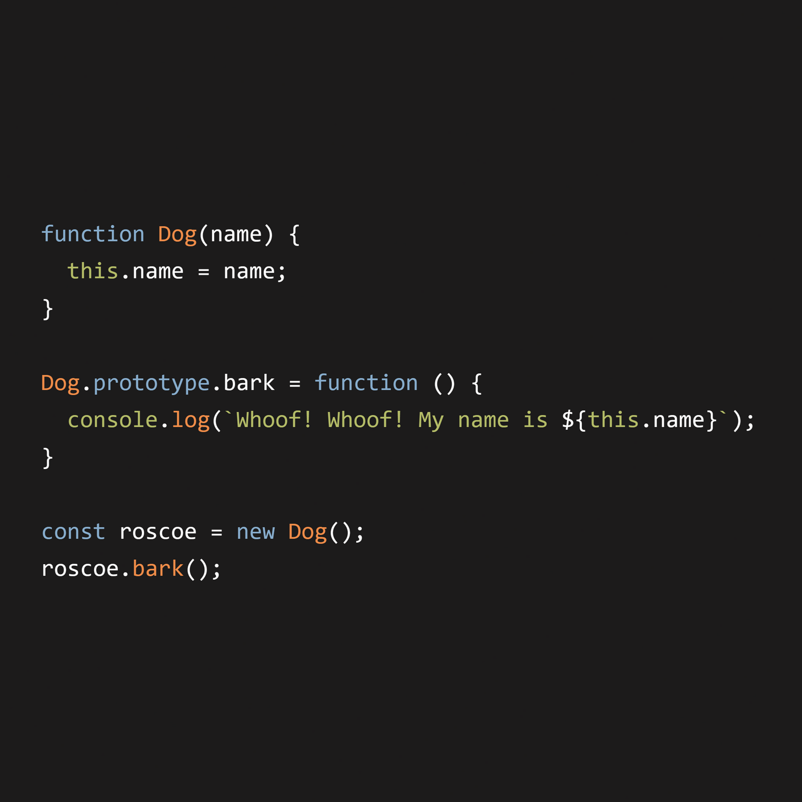
PROTOTYPE EXAMPLE

Slide 5
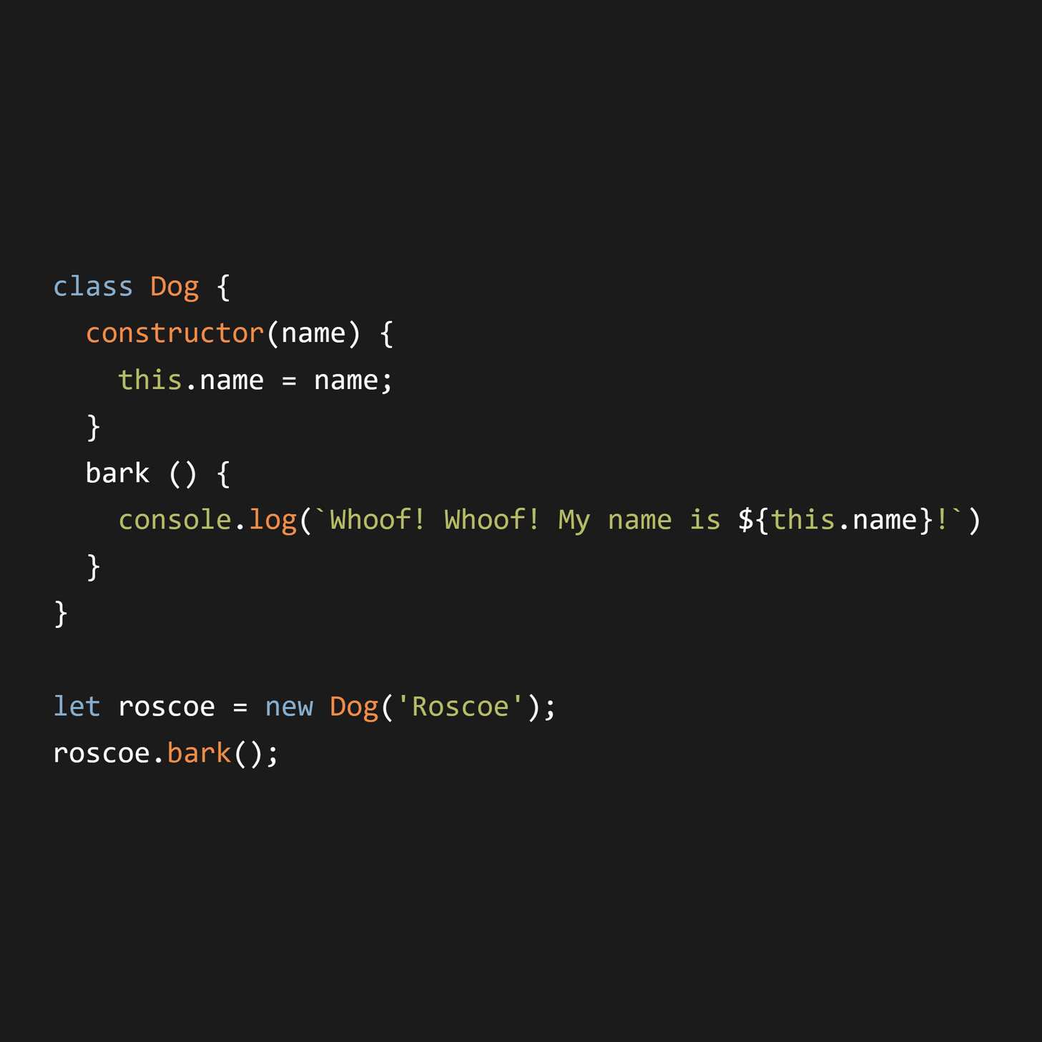
PROTOTYPE EXAMPLE

Slide 6
> Prototypes vs Classes...
Prototypes | Classes
Objects that other objects inherit from. | Templates for creating objects (a.k.a blueprints)
Prototype-based inheritance. | Class-based inheritance.
Objects are created from other objects. | Objects are instantiated from classes.
More dynamic, can modify prototypes at runtime. | More structured, defined at design-time.
Shared through the prototype chain. | Shared through class instances.
Defined on the prototype. | Defined inside the class.
Methods shared via prototype save memory. | Each instance gets its own copy of methods (unless using static methods).

Slide 7
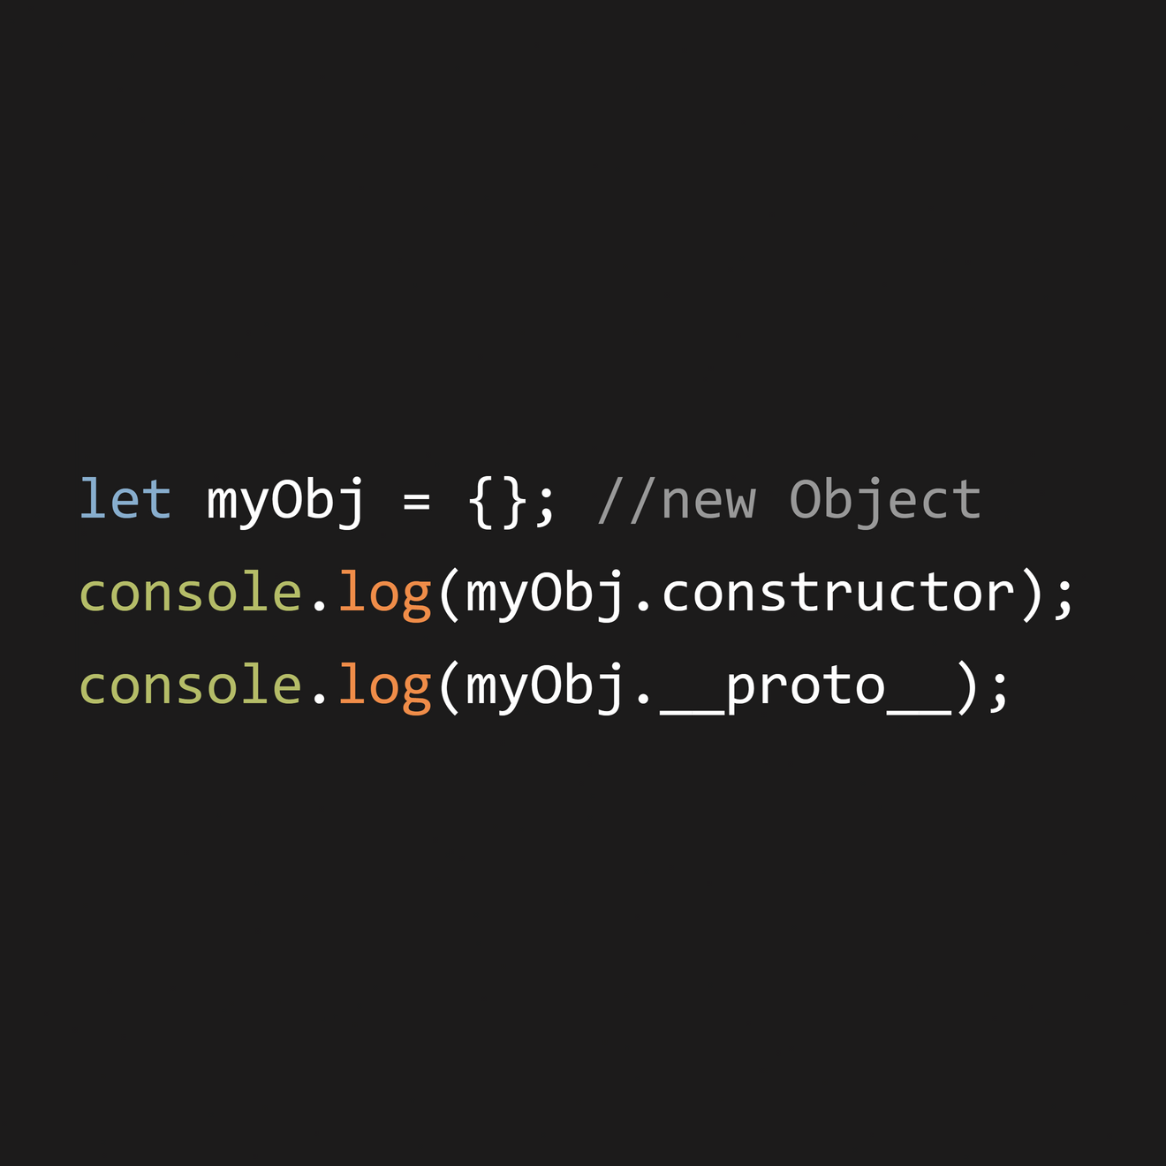
PROTOTYPAL INHERITANCE
The `myObj` object is defined as a blank object
By default, it will inherit whatever properties from `Object.prototype`

Slide 8
null
__proto__
Object
Prototype
__proto__
myObj
Constructor
new Object()

Slide 9
What is __proto__?
__proto__ (pronounced as “dunder proto”) is a special property in JavaScript that points to the prototype of the object.
It establishes the link to another object from which properties and methods can be inherited.
__proto__ creates a chain of prototypes. If a property or method is not found on the current object, JavaScript looks up the chain to find it.

Slide 10
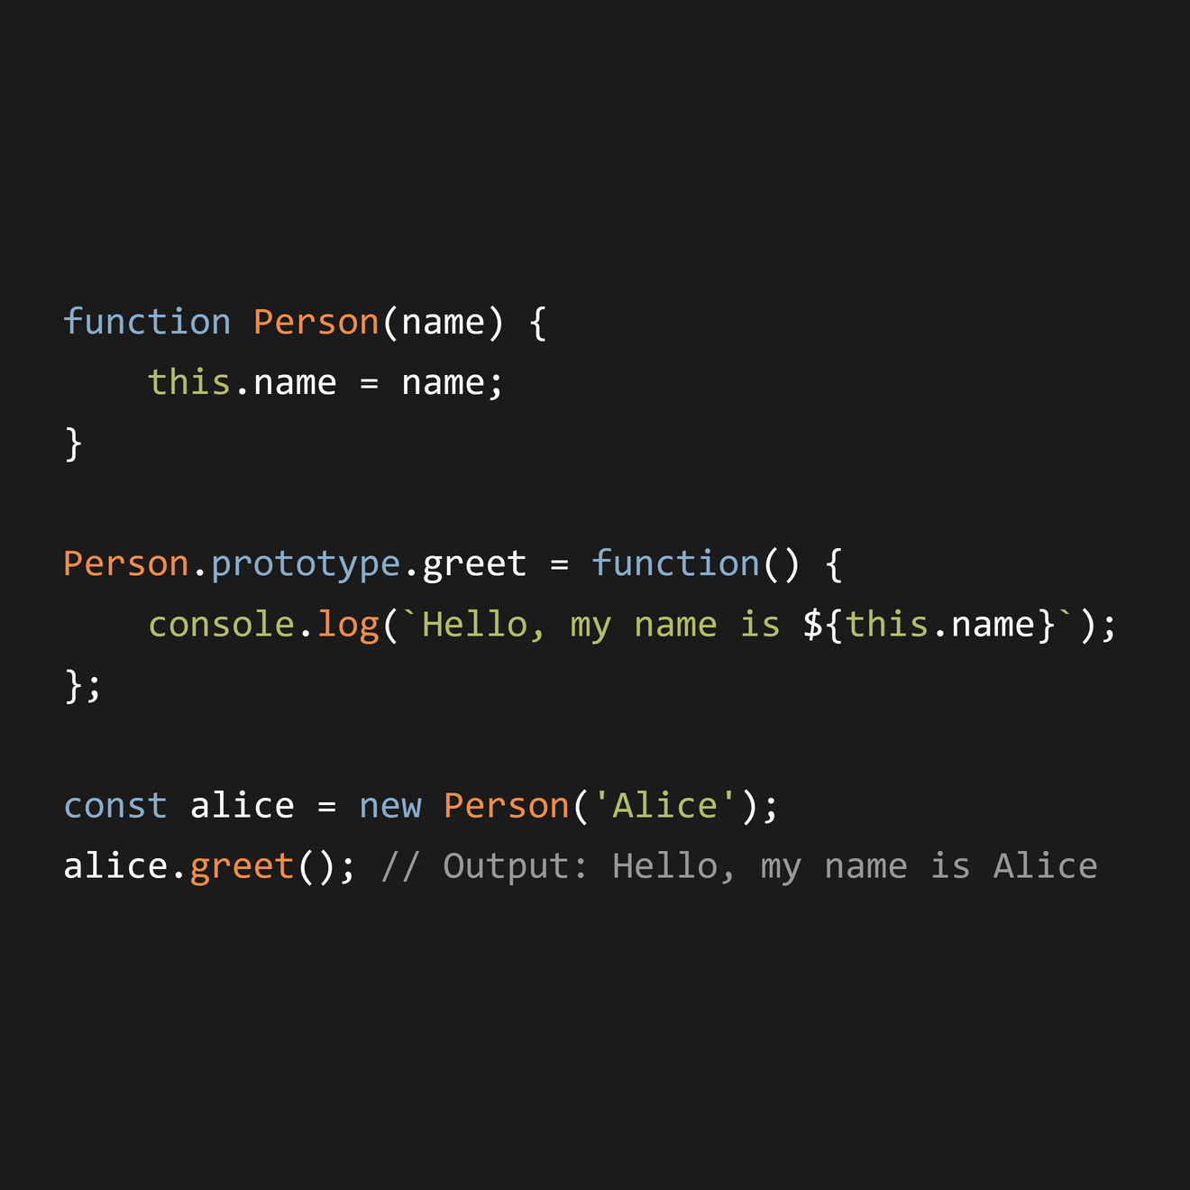
PROTOTYPAL INHERITANCE
The ‘alice’ object inherits the greet method from Person.prototype.
If alice doesn't have a property, JavaScript checks Person.prototype.

Slide 11
null
__proto__
Object
Prototype
__proto__
Person
Prototype
Constructor
new Object()
__proto__
Alice
Object
Constructor
new Person()

Slide 12
NOW...
WHAT’S PROTOTYPE POLLUTION?

Slide 13
So then what is prototype pollution?
Prototype Pollution is a type of vulnerability where an attacker can add or modify properties on an object’s prototype, affecting all objects that inherit from that prototype.
This involves either directly or indirectly modifying the property of an object via __proto__.
Basically its when we use methods that extend object properties without proper validation.

Slide 14
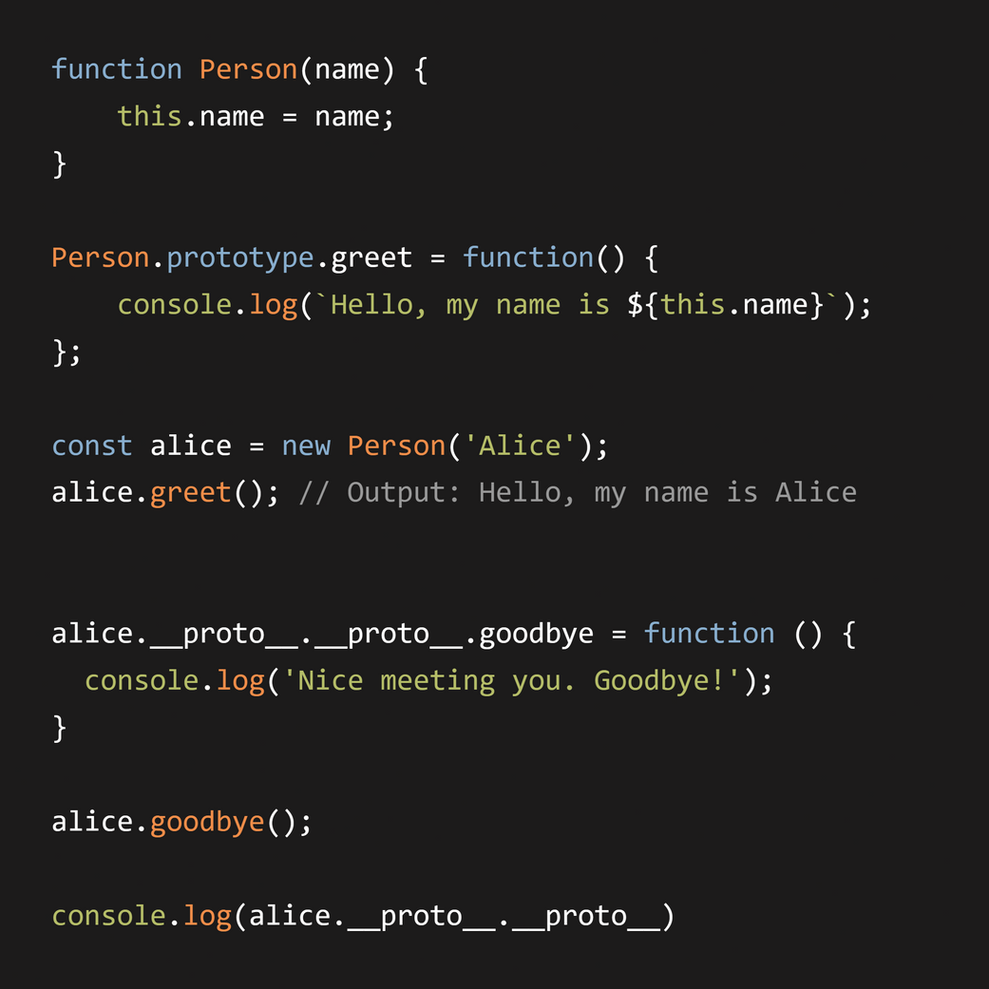
Now by using the __proto__ property, we are able to create a chain that is able to pollute the Object prototype (basically the root of the chain).

Slide 15
null
__proto__
Object
Prototype
alice.__proto__.__proto__
__proto__
Person
Prototype
Constructor
new Object()
__proto__
Alice
Object
Constructor
new Person()

Slide 16
Now by using the __proto__ property, we are able to create a chain that is able to pollute the Object prototype (basically the root of the chain).

Slide 17
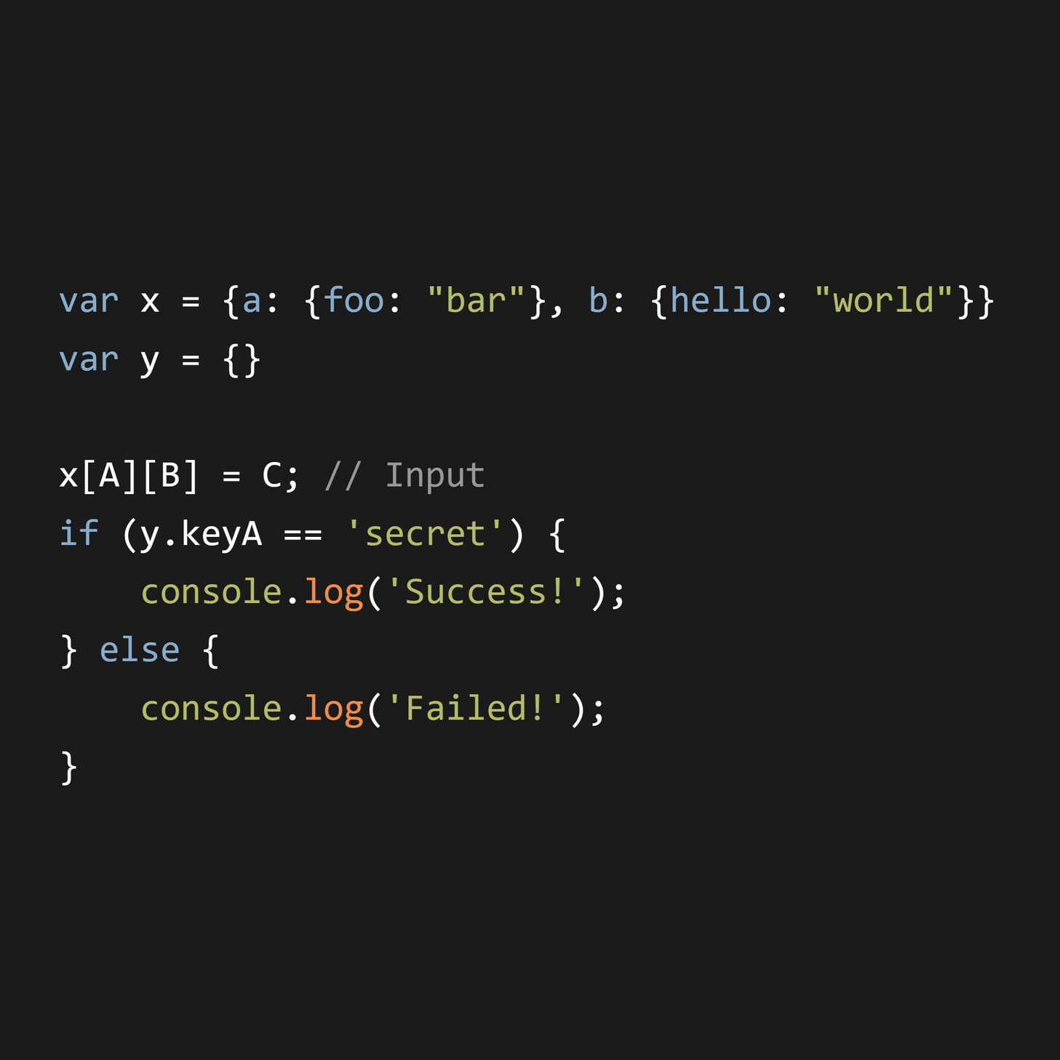
What are the values of A, B and C in this case that will allow us to make the condition true?

Slide 18
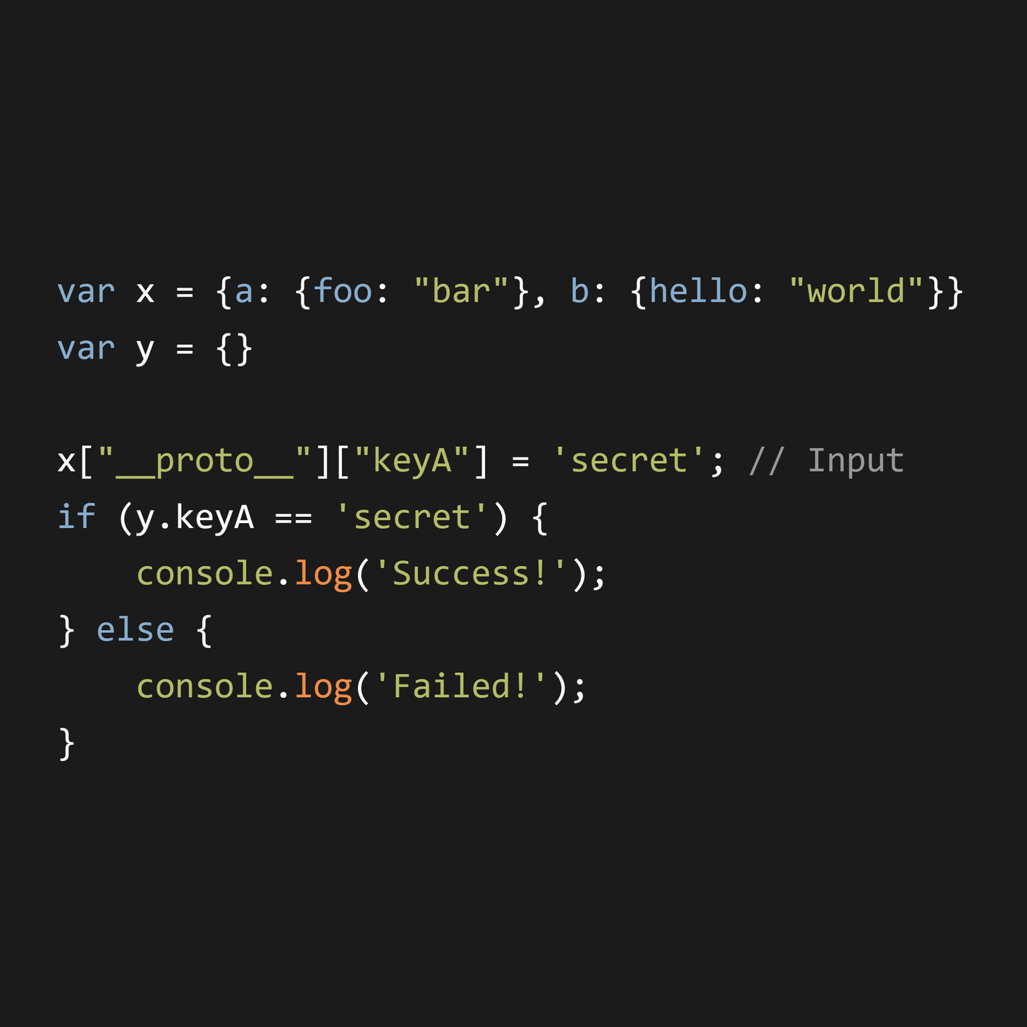
SOLUTION:

Slide 19
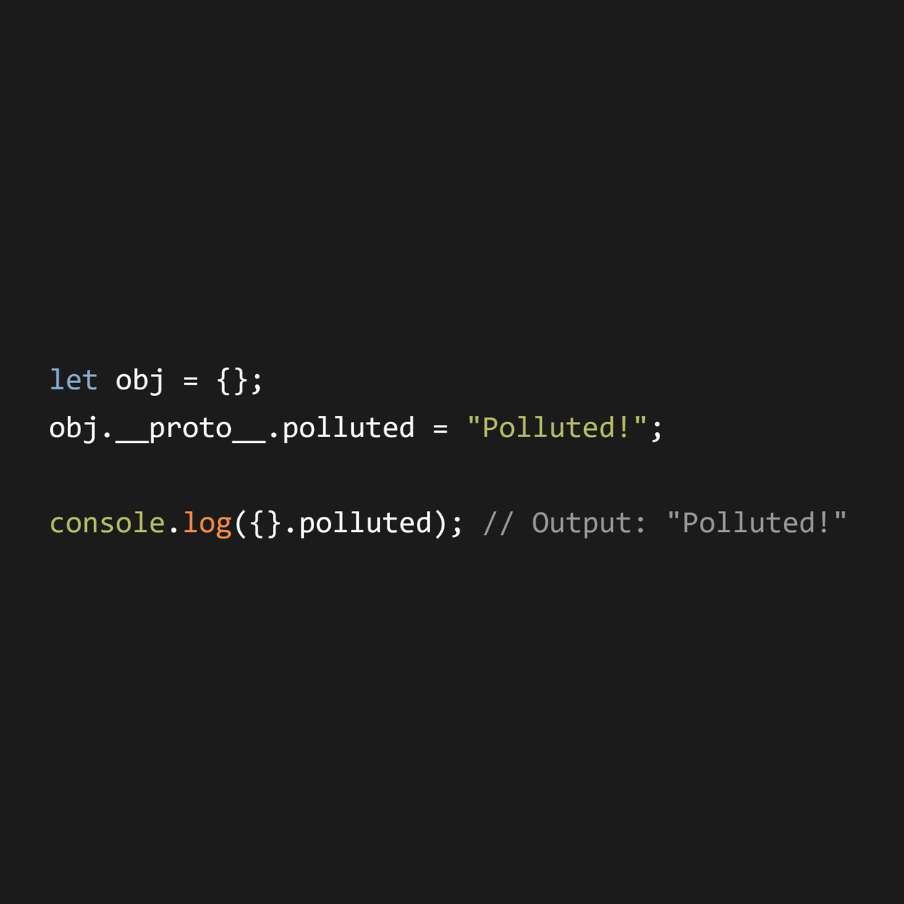
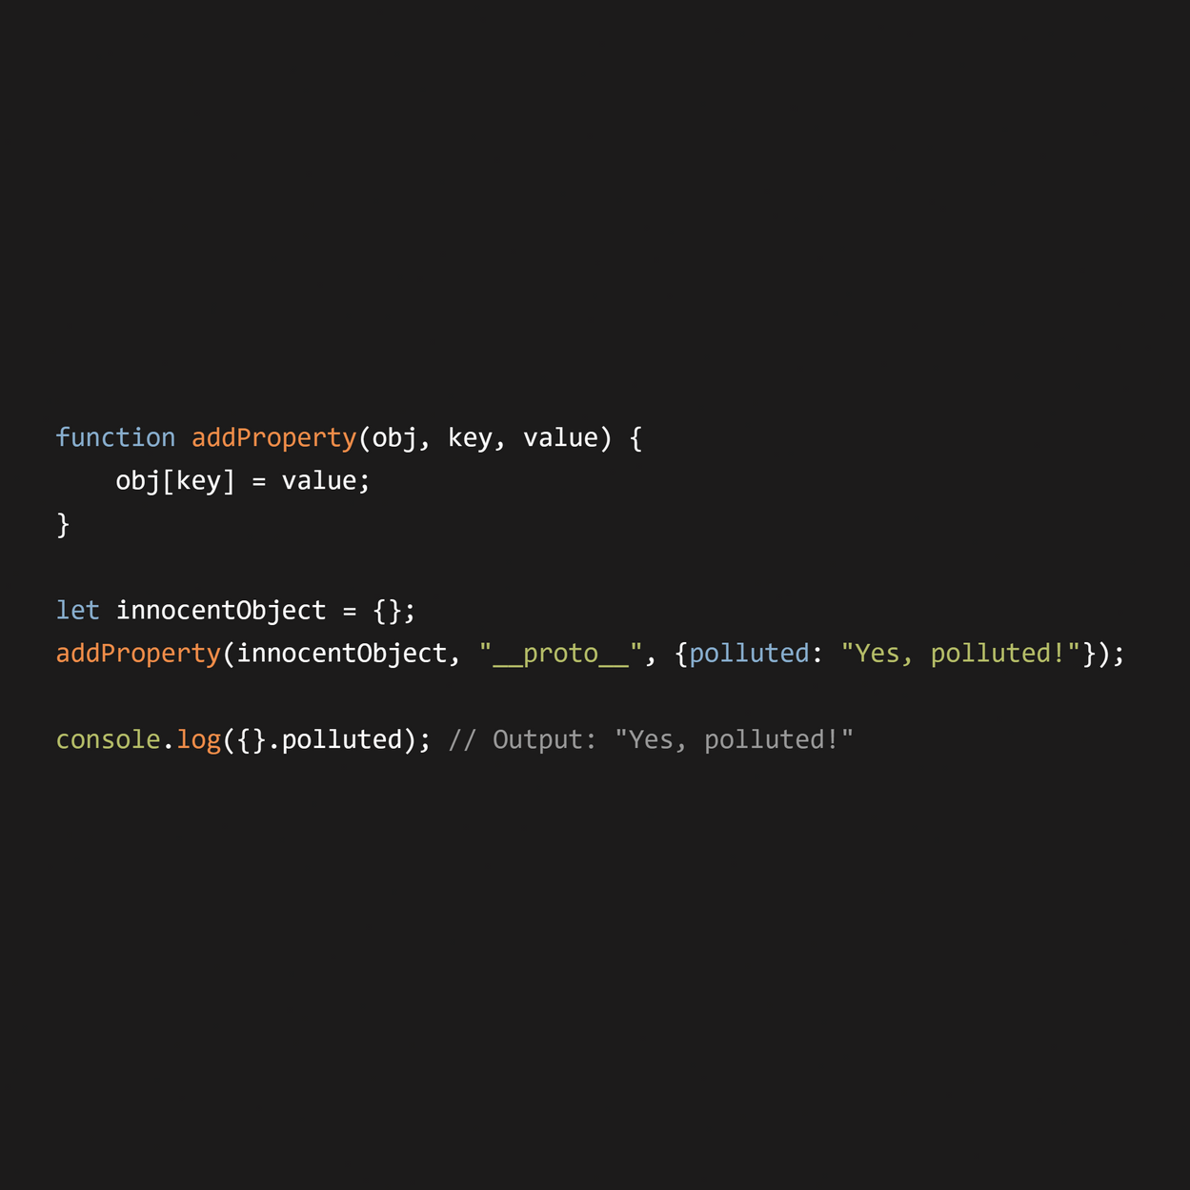
Direct Pollution
Indirect Pollution

Slide 20
NOW...
CTF CHALLENGE EXAMPLES

Slide 21
Challenge #1
FILESTORAGE
Dreamhack

Slide 22
Challenge #2
FUNNYLOGIN
DiceCTF 2024

Slide 23
THANK YOU

